Slide 1


IOT-BASED FIRE ALARM SYSTEM
Experiment 7
Raphael S. Nano
CPE162P / C1
Computer Engineering Department
School of Electrical, Electronics, and Computer Engineering

Slide 2
Introduction: IoT-based Fire Alarm System
Fire alarm systems are crucial in constructing a building, whatever purpose the building may have.
With the addition of an accurate detection system with several sensors and the like, the prevention of the fire itself becomes more efficient.
Moreover, with the implementation of IoT with fire alarm systems, the notification of fire detections and the area in which it occurred can be shown to and seen by the user remotely.

Slide 3
Objectives
To demonstrate how an IoT-based Fire Alarm System works in a 4-storey building.
To be able apply what were learned in logic circuits and switching theory, microprocessors, CPE160P, and CPE161P.
To be able to apply embedded systems with IoT using Arduino kit
To be able to use ThingSpeak for the data collection and analysis.

Slide 4
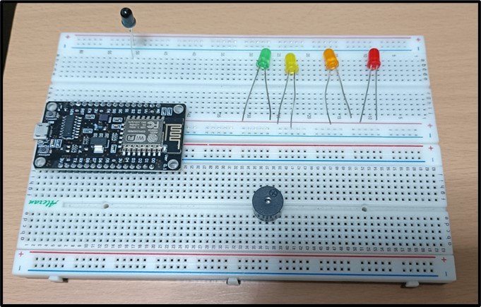
Materials
Hardware
2 Pin Flame sensor
Passive Buzzer
LEDs
Button
ESP8266 WiFi Module

Slide 5
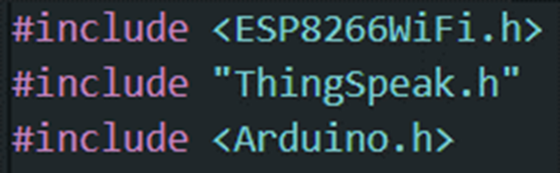
Materials
Software Libraries
ESP8266WiFi.h
ThingSpeak.h

Slide 6
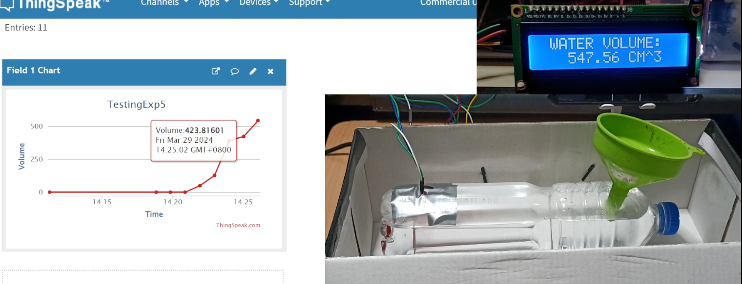
Discussion: IoT-based Fire Alarm System
Experiment 7 aims to:
  Create a system where it will sense the fire using the flame sensor and activate the buzzer correspondingly
  Use LEDs in order to have floor indicators
  Utilize ThingSpeak to show if the fire alarm in a certain floor was turned on

Slide 7
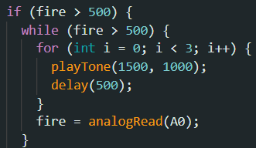
Discussion: IoT-based Fire Alarm System
Three Main Functions
  Detection of Flame Sensor
  Alarming of Buzzer
  Lighting of LEDs
Flame Sensor Function:
  Normal reading is 100
  Flame threshold was set to 500

Slide 8
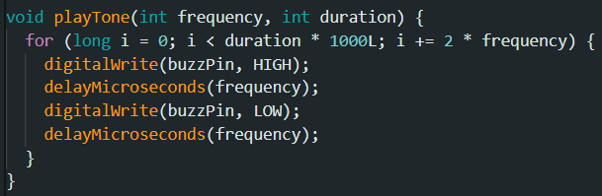

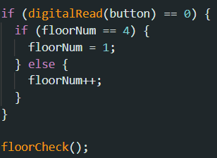
Discussion: IoT-based Fire Alarm System
Passive Buzzer Function:
  Activated using a separate playTone() function
  Uses frequency and duration.
LEDs Function:
  a button was utilized to switch from one to four, then back to one
  Green LED is for Floor 1, Yellow for Floor 2, Orange for Floor 3, and Red for Floor 4

Slide 9
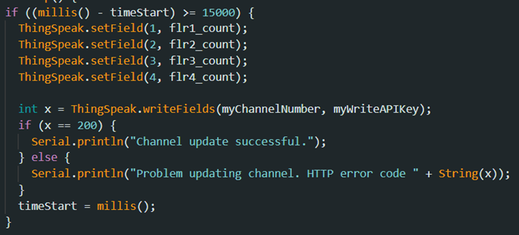
Discussion: IoT-based Fire Alarm System
ThingSpeak Function:
  Every 15 seconds, the status of each floor would be displayed as one (there is a fire) or zero (no fire).

Slide 10
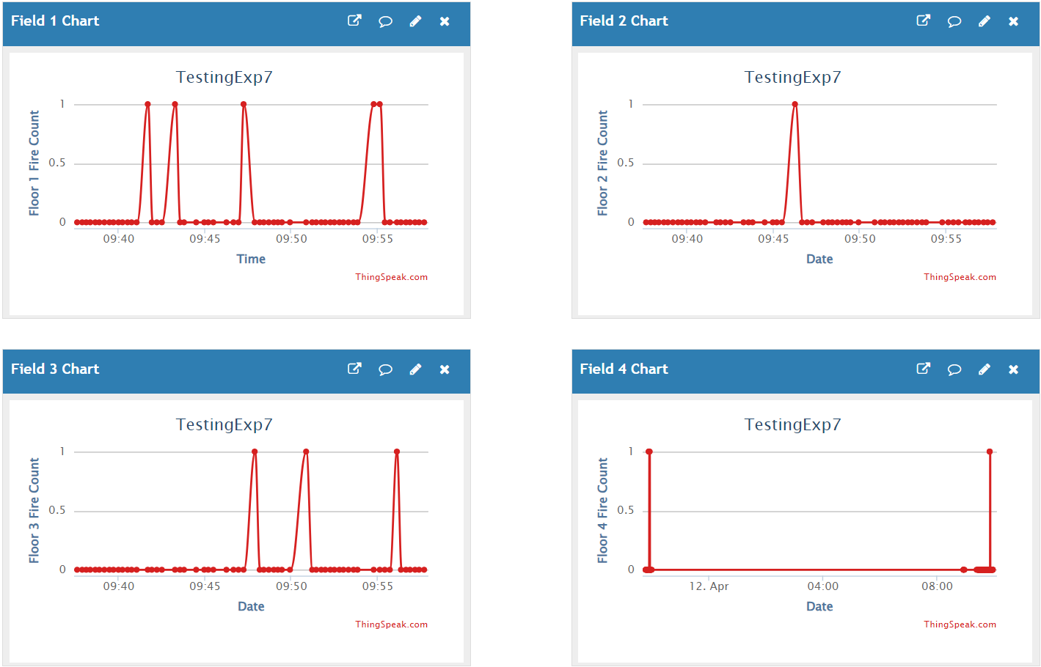
Results: IoT-based Fire Alarm System
Floor 1:
  Triggered the alarm four times, one continuous
Floor 2:
  Triggered the alarm once
Floor 3:
  Triggered the alarm thrice
Floor 4:
  Triggered the alarm twice; both are far from each other

Slide 11
Conclusion
The IoT-based Fire Alarm System works in a 4-storey building with the following operations:
  the flame sensor detects fire with threshold of 500
  the passive buzzer alarms thrice after detection
  an LED shows what floor is currently being detected
  the button is used to switch among floors

Slide 12
Conclusion
To apply past lessons:
  the proper connection of wires
  application of the codes
  the implementation of IoT were done
ThingSpeak was synchronized successfully with the ESP8266, wherein it outputs every 15 seconds
Therefore, An embedded systems with IoT was created using the flame sensor, passive buzzer, LEDs, a button, and the ESP8266.

